Slide 1


Contact
AUTONOMUS ROBOT NAVIGATION SYSTEM
Devarasetty Kuldeep - CB.SC.U4CSE24712
Pasumarthy Abhinav - CB.SC.U4CSE24738
Rudraraju Ethish - CB.SC.U4CSE24761
Namburi Vivek - CB.SC.U4CSE24762

Slide 2


INTRODUCTION
IN THIS PROJECT, WE HAVE DESIGNED A SMALL MOBILE ROBOT CAPABLE OF NAVIGATING ITS ENVIRONMENT AUTONOMOUSLY. THE ROBOT CAN MOVE SAFELY, FOLLOW PATHS, AND BE CONTROLLED REMOTELY, DEMONSTRATING INTELLIGENT AND FLEXIBLE NAVIGATION.

Slide 3

INTRODUCTION
IMPLEMENTED USING ARDUINO UNO R4.
USED C PROGRAMMING CONCEPTS: LOOPS, CONDITIONALS, FUNCTIONS, ARRAYS, INTERRUPTS,AND STRUCTURES.
MODULAR DESIGN FOR EASY CODE MANAGEMENT.
INTEGRATES SENSORS, MOTORS, AND WIRELESS COMMUNICATION.
DEMONSTRATES A COST-EFFECTIVE REAL-WORLD EMBEDDED SYSTEM.

Slide 4
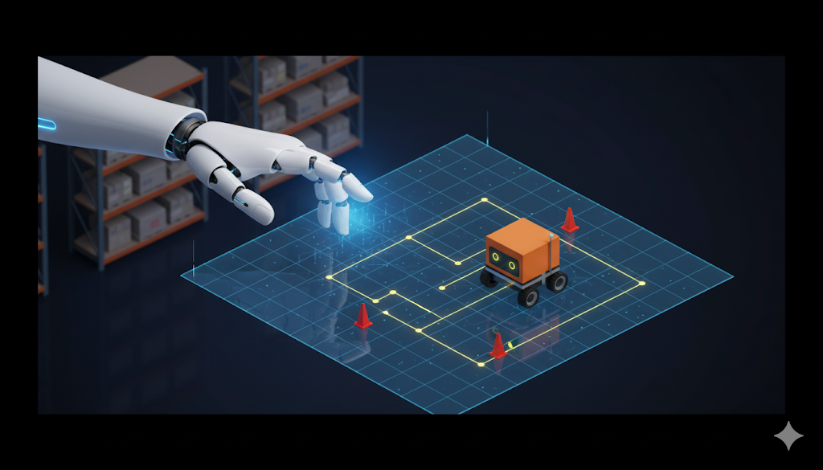
PROBLEM STATEMENT
IN CONTEMPORARY ROBOTICS, AUTONOMOUS DRIVING AND REMOTE CONTROL ARE FUNDAMENTAL FEATURES FOR ROBOTS IN VARIOUS ENVIRONMENTS.
APPLICATIONS LIKE WAREHOUSE MANAGEMENT, DELIVERY VEHICLES, AND INSPECTION UNITS REQUIRE ROBOTS TO NAVIGATE PRE-DESIGNED PATHS, AVOID OBSTACLES IN REAL-TIME, AND ALLOW MANUAL CONTROL.
CHALLENGE: IMPLEMENT THESE IN A LOW-COST SYSTEM USING BASIC C PROGRAMMING.

Slide 5

WORKING
PRINCIPLE:
Obstacle Avoidance Mode:
Path Following Mode:
Manual Control Mode:
Goal
Build using Arduino UNO R4 with C code incorporating variables, conditionals, loops, arrays, functions, and interrupts.
Uses an ultrasonic sensor to detect and steer around obstacles.
Uses IR sensors to follow a marked ground path.
Controlled by the user through Bluetooth.

Slide 6
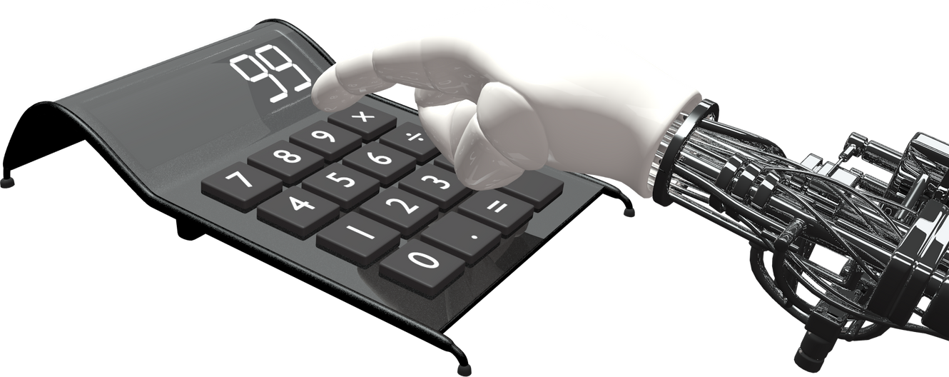
HARDWARE REQUIREMENTS
CORE COMPONENTS:
ARDUINO UNO R4 WIFI: MAIN MICROCONTROLLER WITH BUILT-IN WI-FI & BLUETOOTH.
L298N Motor Driver MODULE: CONTROLS DC MOTOR DIRECTION AND SPEED.
65MM ROBOT WHEELS: COMPATIBLE WITH MOTORS.
SERVO MOTOR
SENSOR EXTENSION PLATE
300 RPM BO MOTOR-STRAIGHT
SENSORS:
HC-SR04 ULTRASONIC SENSOR: OBSTACLE DETECTION.
3 X TCRT5000 TRACING MODULE
POWER SYSTEM:
6 × AA BATTERIES
BATTERY HOLDER (6-CELL): MOUNTS BATTERIES

Slide 7
HARDWARE REQUIREMENTS
ADDITIONAL COMPONENTS:
NUTS & BOLTS, CONNECTORS ASSEMBLY.
PCB: WIRING.
CHASSIS
SERVO MOTOR BRACKET SET
1 X 40PIN DUPONT LINE(MALE-FEMALE)

Slide 8

SOFTWARE REQUIREMENTS
Arduino IDE
WebApp
Frontend Development: HTML5, CSS3, JavaScript (for responsive interface and BLE control)
BLE Communication: Web Bluetooth API (for connecting to and controlling the robot)
Code Editor: Visual Studio Code
Browser Support: Google Chrome (supports Web Bluetooth API)
Microcontroller Programming: Arduino IDE (for robot firmware and BLE module setup)
For writing and uploading C code to Arduino UNO R4.

Slide 9


SYSTEM ARCHITECTURE
1. Input Layer (Sensors & User Control):
2. Processing Layer:
Ultrasonic Sensor (HC-SR04): Measures distance for obstacles.
IR Line Tracking Sensors (TCRT5000): Detect black/white contrast for paths.
Bluetooth Module (built-in Arduino): Receives commands from User-Interface.
Switches modes from a selection shown to the user (HTML page).
Executes C code to process data, apply logic, and send signals.
Switches modes based on selection from the user.
Bluetooth inputs from the user handles the operation of TurtleBot.
Runs algorithms for obstacle detection and line following.

Slide 10
SYSTEM ARCHITECTURE
3. Output Layer (Actuators & Indicators):
L298N Motor Driver: PWM and direction signals for motors.
DC Gear Motors with Wheels: Movement.
Operation and working of TurtleBot based on the insights gained from Processing Layer.

Slide 11
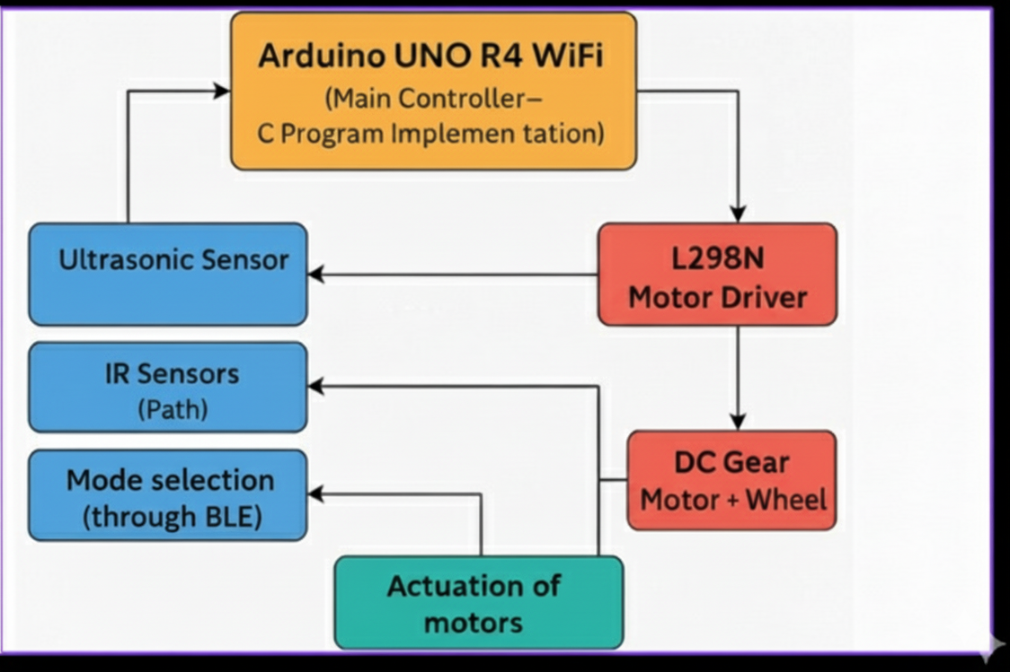
FLOW DIAGRAM
(Component Block Diagram)

Slide 12
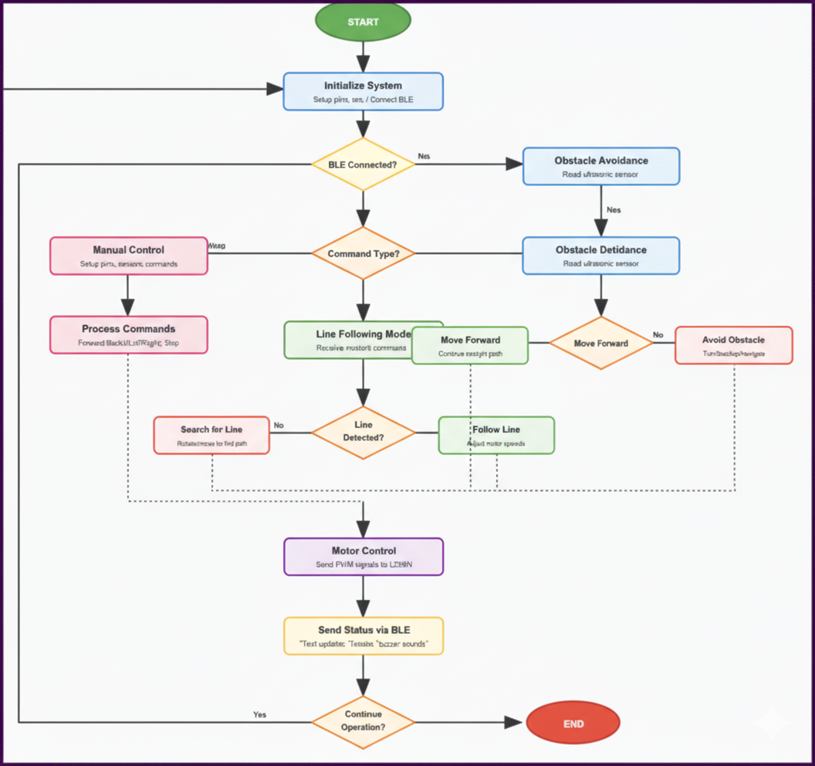
FLOW D
I
AGRAM

Slide 13

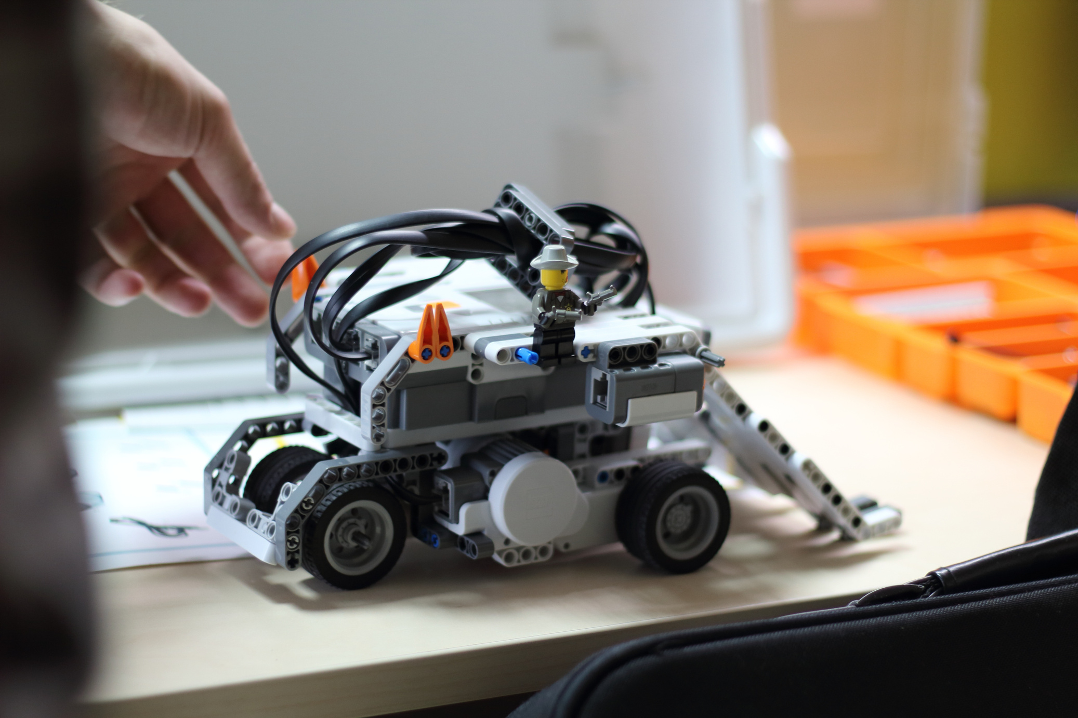
C PROGRAMMING CONCEPTS & DESIGN PRINCIPLES
1. BASIC STRUCTURE & FLOW:
3. FUNCTIONS & MODULARITY:
Program Entry: setup() + loop() in Arduino.
Sequential, Conditional, Iterative: if/else, loops, switch-case.
DECOMPOSITION: BREAK TASKS INTO REUSABLE FUNCTIONS (E.G., READSENSOR()).
PARAMETERS: PASS BY VALUE OR POINTER.
RETURN VALUES: GET RESULTS FROM FUNCTIONS.
MODULAR: SEPARATE .C AND .H FILES.
2. ABSTRACTION:
HIDE DETAILS: E.G., MOVEFORWARD() INSTEAD OF RAW PINS.
IMPROVES READABILITY.

Slide 14
C PROGRAMMING CONCEPTS & DESIGN PRINCIPLES
5. DATA & VARIABLES:
4. STRUCTURES & DATA GROUPING:
PRIMITIVE TYPES: INT, FLOAT, CHAR, UNSIGNED, BOOL.
CONSTANTS & MACROS: CONST
STRUCT: BUNDLE VARIABLES (E.G., SENSOR DATA).
COMBINE WITH POINTERS FOR DYNAMICS.
6. CODE REUSABILITY:
Headers: Declarations for motors/sensors.
Libraries: WiFi, etc.; DRY principle.

Slide 15

C PROGRAMMING CONCEPTS & DESIGN PRINCIPLES
7. EVENT HANDLING :
9. POINTERS & MEMORY MANAGEMENT:
POLLING-BASED EVENT DETECTION
TIME-BASED EVENT MANAGEMENT
STATE-DRIVEN EVENT RESPONSE
CONNECTION STATE EVENTS
REAL-TIME SENSOR EVENTS
PASS BY REFERENCE VS PASS BY VALUE
DIRECT MEMORY MODIFICATION
STRUCTURE MEMBER ACCESS VIA POINTERS
POINTER AS FUNCTION ARGUMENTS
MEMORY EFFICIENCY BENEFITS
PREVENTING NULL POINTER ISSUES
8. DEFENSIVE PROGRAMMING:
INPUT VALIDATION & SANITIZATION
SENSOR READING VALIDATION
CONNECTION STATE CHECKING
TIMEOUT PROTECTION
SAFE MODE TRANSITIONS
Boundary Checks & Safe Defaults
Error Recovery Strategies
Initialization Safety

Slide 16
C PROGRAMMING CONCEPTS & DESIGN PRINCIPLES
10. ARRAYS & STRINGS:
12. BITWISE OPERATIONS:
ARRAYS STORE MULTIPLE VALUES OF THE SAME TYPE IN CONTIGUOUS MEMORY.
USEFUL FOR STORING SENSOR READINGS, PIN STATES, OR MOTOR SPEEDS.
FOR PORTS, MASKING: &, |, ^, ~, <<, >>.
13. STATE MACHINES:*
enums :Commonly used for mode-based control: idle, forward, stop, etc.
switch-case: Uses switch-case to handle state behavior:
11. DOCUMENTATION & READABILITY:
NAMING CONVENTIONS; COMMENTS; INDENTATION.

Slide 17
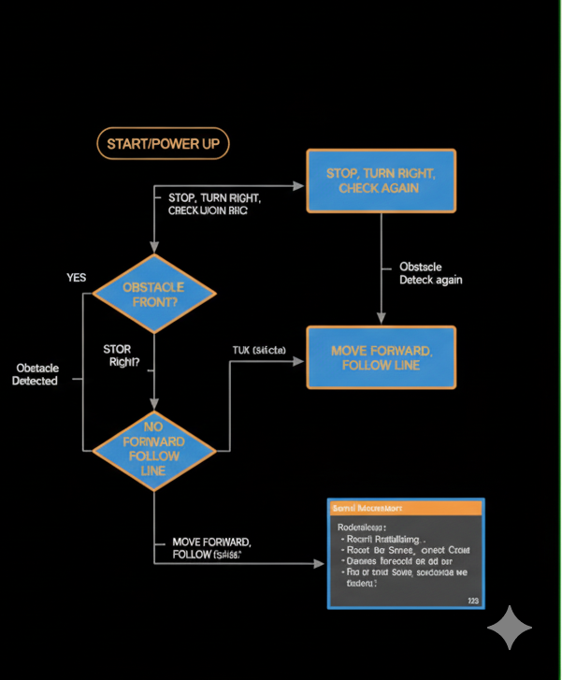
EXPECTED OUTPUT
1. Power-Up & Initialization:
Initializes sensors, motors, serial.
2. Normal Operation:
Movement: Forward until obstacle; stop/turn if <10 cm
IR Tracking: Follows line; "Following track..."
3. FINAL DEMONSTRATION:
AUTONOMOUS NAVIGATION AVOIDING OBSTACLES.
AUTONOMOUS LINE - TRACKING NAVIGATION.
MODE SWITCHING VIA USER INPUT.
SMOOTH CONTROL; REAL-TIME RESPONSE.

Slide 18
REFERENCeS
1. EMBEDDED C & ARDUINO:
ARDUINO DOCS: HTTPS://DOCS.ARDUINO.CC
PROGRAMMING EMBEDDED SYSTEMS IN C AND C++: HTTPS://BARRGROUP.COM/EMBEDDED-SYSTEMS/HOW-TO/EMBEDDED-C-PROGRAMMING
2. HARDWARE DATASHEETS:
ARDUINO UNO R4 WIFI: HTTPS://DOCS.ARDUINO.CC/HARDWARE/UNO-R4-WIFI
HC-SR04: HTTPS://CDN.SPARKFUN.COM/DATASHEETS/SENSORS/PROXIMITY/HCSR04.PDF
TCRT5000: HTTPS://WWW.VISHAY.COM/DOCS/83760/TCRT5000.PDF
L298N: HTTPS://WWW.ST.COM/RESOURCE/EN/DATASHEET/L298.PDF

Slide 19
THANK YOU

